Slide 1
Class 2DF Group 61 SPRINT 3
Group members:
Carolina Sá (1220623)
David Sousa(1220784)
Rodrigo Correia (1220604)
Tiago Carvalho (1221124)

Slide 2
Sprint planning – Sprint 3
Planned Start Date: 30/11/2023 Real Start Date: 06/12/2023
Planned Finished Date: 03/01/2024 Real Finish Date: 03/01/2024
SPRINT BACKLOG
Number of stories: 29
Number of bugs: 8
Number of tasks: 29
Number of Management Tasks: 2
Number of team members | Planned: 4 Actual: 4
Total planned estimation vs execution | Planned hours: Executed hours:

Slide 3
Sprint planning
Assignment US | Commited? | Todo | Doing | Testing | Done | Blocked
US AC06 | YES |  |  |  | X
US AC07 | YES |  | X
US AC08 | YES |  |  | X
US AC09 | YES |  |  | X
US AC10 | YES |  | X
US AC11 | NO | X
US AC12 | YES |  |  | X
US AC13 | YES |  |  | X
US BD24 | YES |  |  |  | X
US BD25 | YES |  |  |  | X
US BD26 | YES |  |  |  | X
US BD27 | YES |  |  |  | X

Slide 4
Sprint planning
Assignment US | Commited? | Todo | Doing | Testing | Done | Blocked
US BD28 | YES |  |  |  | X
US BD29 | YES |  |  |  | X
US BD30 | YES |  |  |  | X
US BD31 | YES |  |  |  | X
US BD32 | YES |  |  |  | X
US BD33 | YES |  |  | X
US EI06 | YES |  |  |  | X
US EI07 | YES |  |  |  | X
US EI08 | YES |  |  |  | X
US EI09 | YES |  |  |  | X
US EI11 | YES |  |  |  | X
US FA05 | YES |  |  |  | X

Slide 5
Sprint planning
Assignment US | Commited? | Todo | Doing | Testing | Done | Blocked
US FA06 | YES |  |  |  | X
US FA07 | YES |  |  |  | X
US FA08 | NO |  |  |  |  | X
US LP10 | YES |  |  |  | X
US LP11 | YES |  |  |  | X
-
-
-
-
-
-
-

Slide 6
Work by team member

Slide 7
Work by type

Slide 8
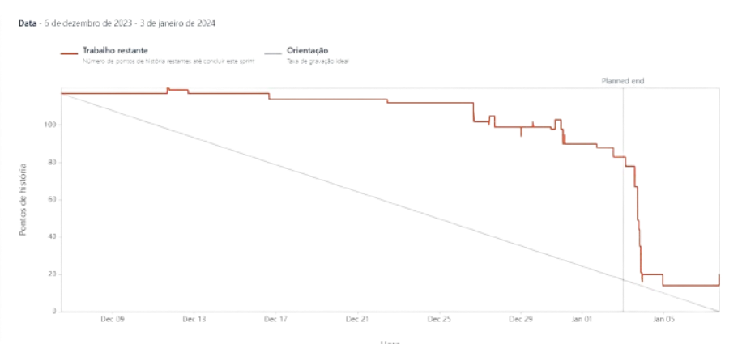
Sprint Burndown Chart

Slide 9
Sprint Retrospective
Date: 07/01/2024
What went well?
We started by LAPR3 and BDDAD components (which were the ones with most weight in final grades) and completed almost every User Story, except an individual one from BDDAD.
What went wrong?
Once again, we started work many time after planned.
Having classes while we did the project didn’t go well because we didn’t learn important materials because we had to do the project (in classes also).
What we’ve learned?
We must start work on the planned date, or else it won’t be possible to achieve all user stories’ completion on time.

Slide 10
Sprint Retrospective
Date:
Action items:
Reducing the number of bugs in the project.
Enhancing the quality of the project through unit tests.

